Slide 1

Camping Ordinance Training

Slide 2
South Miami is widely recognized for its essence of a cozy hometown, where neighbors know each other by name.
Recently, there has been an increase of unhoused persons who’s names the community does not know.
Residents and business owners alike have expressed much concern for the physical and mental safety of the displaced individuals.
As a result, the City of South Miami has implemented a new camping ordinance, to continue the tradition of being the City of Pleasant Living

Slide 3
The South Miami Police Department has been tasked with implementing and enforcing the new camping ordinance.
With SMPD’s mission statement in mind, officers will professionally engage with the community, and provide a safe and secure environment for all.
In order to meet the above expectation, an officer must first know and understand the ordinance.

Slide 4
objectives
Provide an overview of the camping ordinance
Outline the steps officers should take when encountering individuals violating the camping ordinance
List available resources

Slide 5
Chapter 15, Article I, Section 15-65 of the
City of South Miami Code
Overnight Camping prohibited
(a) It shall be unlawful to engage in overnight camping on public property, including rights-of-way, except as may be specifically authorized by the appropriate governmental authority.

Slide 6
Chapter 15, Article I, Section 15-65 of the
City of South Miami Code
Overnight Camping prohibited
(b) "overnight camping" is defined as:
(1) Sleeping or otherwise being in a temporary shelter out-of- doors from the hours of sunset to sunrise;
(2) Sleeping out-of-doors and/or on public property from the hours of sunset to sunrise
(3) Cooking over an open flame or fire out-of-doors on public property from the hours of sunset to sunrise; or
(4) Conducting activities of daily living such as sleeping or storage of personal possessions in public places from the hours of sunset to sunrise.

Slide 7
Chapter 15, Article I, Section 15-65 of the
City of South Miami Code
Overnight Camping prohibited
(c) Enforcement and Penalties.
The enforcement procedures and penalties set forth in this section are specifically tailored to address and assist individuals in achieving compliance.
Any person who violates this section, shall first receive a written warning, which may be accompanied by written information regarding the availability of medical treatment (including mental health treatment) or social services (including temporary shelter or drug or alcohol rehabilitation),
And if found to thereafter be in violation of this section, shall be guilty of a misdemeanor and, upon conviction, shall be punished either by a fine up to $500.00, imprisonment in the county jail up to 60 days, or both.

Slide 8
Chapter 15, Article I, Section 15-65 of the
City of South Miami Code
Overnight Camping prohibited
(c)(1) The city shall not prosecute a criminal violation following arrest if the violator provides proof, within ten (10) days of the arrest, that the violator is documented in a Homeless Management Information System accessible by the City, and:
a. the violator is on a wait-list for housing, including shelter assistance through a government or charitable organization, as verified by the City’s social services representative; or
b. after arrest, the violator applied for housing, including shelter assistance through a government or charitable organization, as verified by the City’s social services representative.

Slide 9
Chapter 15, Article I, Section 15-65 of the
City of South Miami Code
Overnight Camping prohibited
(c)(2) This section shall not be enforced for 90 days from its effective date so that known persons who engage in public camping can be contacted and be given a reasonable opportunity to meet with the City’s social services representative regarding available social services, which may include the availability of medical treatment (including mental health treatment) or social services (including temporary shelter or drug or alcohol rehabilitation).

Slide 10
Chapter 15, Article I, Section 15-65 of the
City of South Miami Code
Overnight Camping prohibited
(c)(3) This section shall not be enforced against a violator who is on a wait-list for housing, including shelter assistance through a government or charitable organization, provided the violator has not refused assistance, voluntarily left such housing once it has been obtained, or had their housing terminated for failure to follow the required policies for such housing.

Slide 11
Key concepts in initiating interactions
The primary purpose of the ordinance is to assist individuals in obtaining the help they need such as:
Shelter
Getting identification
Reconnecting with family
Keeping this goal in mind, officers should:
Try their best efforts to communicate what the ordinance entails
Recognize that lack of resources may be a hindrance for the individual
Share and explain that there are resources available

Slide 12
Officer responsibilities
Gather information on the individual found camping
Complete a clearance check
Take a photo of the individual
Offer the person assistance
Document the encounter by completing a field interview card
Provide a printed copy of the field interview card to the individual to serve as a written warning
Provide the resource notice

Slide 13
Gathering information
What is your first and last name?
What is your date of birth?
Are you from Miami?
Do you have family in Miami?
If not from Miami, where did you live before moving here?
Would you be interested in returning to your place of origin?
Where do you usually spend your time?
  Unhoused individuals often seek refuge overnight in a separate location than where they spend their days
Are you currently receiving help from any organizations?
  Have you ever received help?
Are you interested in meeting with a case worker to review what resources are available for you?

Slide 14
When completing the field interview card
Include the answers to the questions from the previous slide
Provide a description of clothing
Share any distinguishing nuisances, as it is important and helpful to the City’s social services representatives and the Community Affairs Officer in identifying the correct person
  Examples:
    Red backpack
    Blue hair
    Purple bike
    Amputee
Advise if the person is an English speaker, or has another language preference
Indicate that a written warning was provided

Slide 15
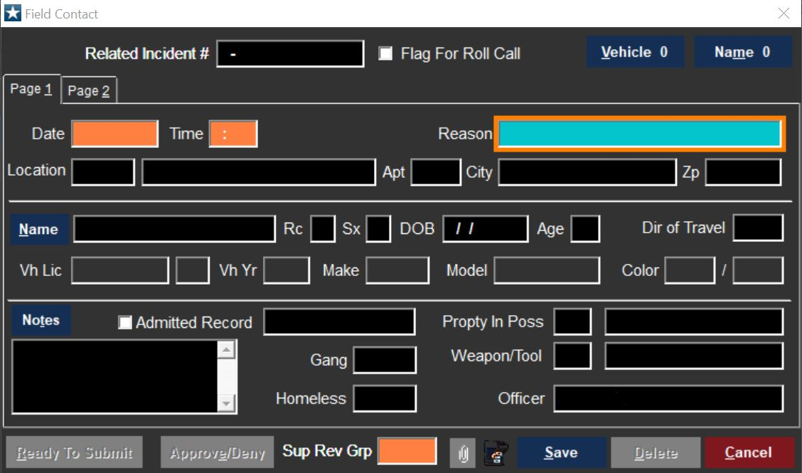
Field interview card

Slide 16
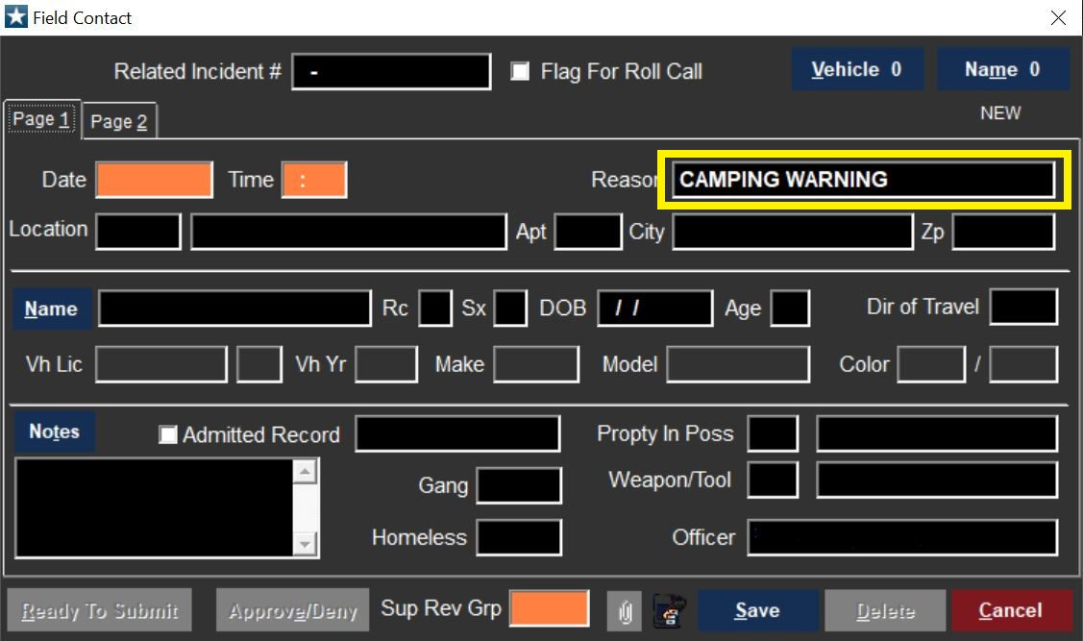
Field interview card

Slide 17
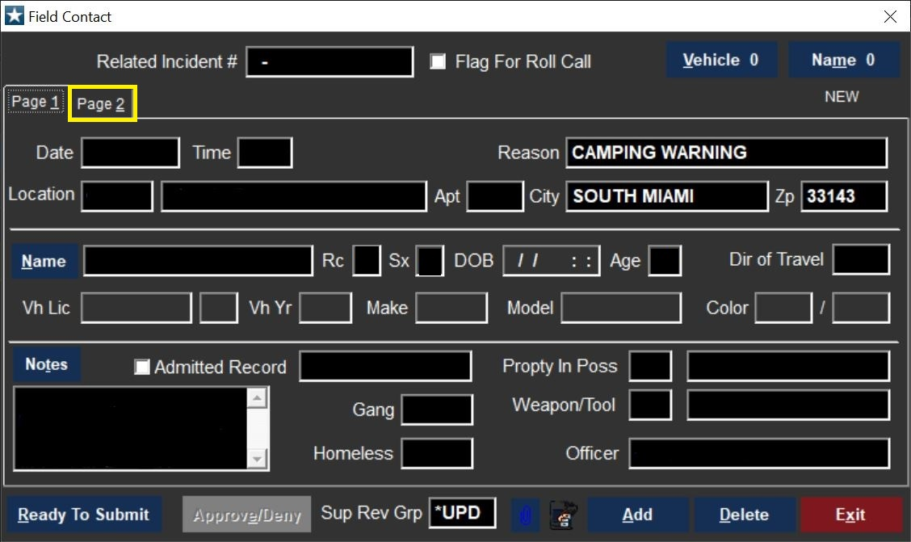
Issue written warning

Slide 18
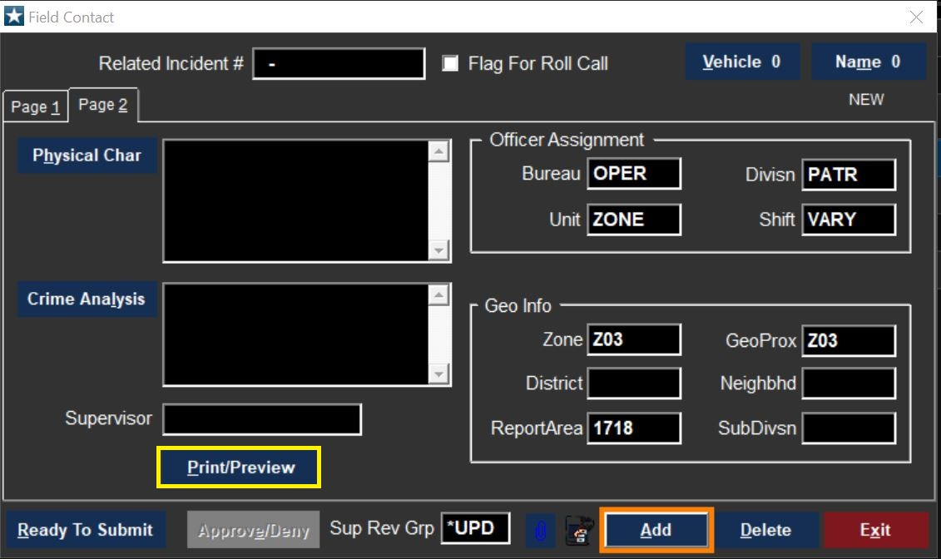
Issue written warning

Slide 19
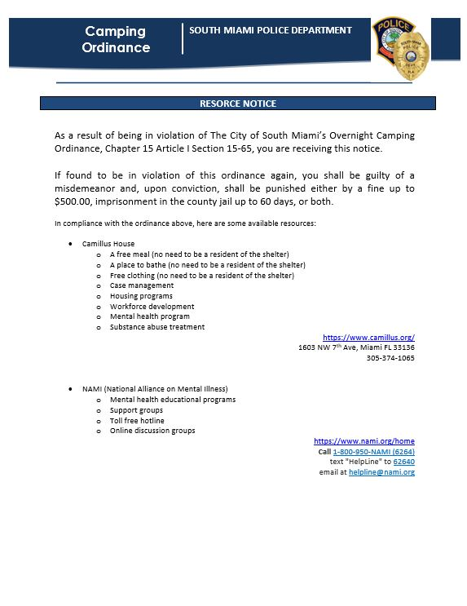

Slide 20
Following up
Should the unhoused person accept assistance, notification must be provided to the SMPD Community Affairs Officer.
  Notification is completed via email; detailing the information documented in the field interview card.
The Community Affairs Officer is the liaison for:
  South Miami’s partnering nonprofit organization, Miami Recovery Project
  South Miami’s reserved spaces within Camillus house
  Homeless shelter’s allowing admissions through homeless trust

Slide 21
Following up
The ordinance states proof of acceptance of assistance should be documented through the Homeless Management System.
SMPD does not have access to this system.
Miami Recovery Project, as SMPD’s partner, is the point of contact for information from the Homeless Management System
The Community Affairs Officer shall utilize information provided via email to forward to Miami Recovery Project for the verification of assistance status.

Slide 22

Miami Recovery Project
The City of South Miami has partnered with the nonprofit organization to have an outreach team and case worker accessible for individuals who are in need of assistance.
The organization provides services such as :
  Co-response with first responders
  Certified event interventionalist
  Veteran crisis intervention
  License clinician
  Overdose prevention
  Groups & meetings
  Treatment resources
  Peer support services
  Homeless outreach team

Slide 23

Camillus House
The City of South Miami has three reserved beds within the shelter
The nonprofit organization provides services such as:
  A free meal (no need to be a resident of the shelter)
  A place to bathe (no need to be a resident of the shelter)
  Free clothing (no need to be a resident of the shelter)
  Case management
  Housing programs
  Workforce development
  Mental health program
  Substance abuse treatment

Slide 24

NAMI
National Alliance on Mental Illness
Nonprofit organization that provides services such as:
  Mental health educational programs
  Support groups
  Toll free hotline
  Online discussion groups
https://www.nami.org/home

Slide 25

Hermanos De La Calle
Nonprofit organization that provides services such as:
  Outreach
  Relocation
  Housing
  Workshops
  Employment
  Legal services
  Case managers
  Peer brothers
  https://www.hermanosdelacalle.org/

Slide 26

Chapman Partnership
Homeless shelter offering programs and services such as:
  Housing
  Workforce development
  Family resource center
  Wellness
https://chapmanpartnership.org/

Slide 27

Agape
Nonprofit organization that provides services such as:
  Community health center
  Residential inpatient treatment
  Mommy & me programs
  Outpatient treatment programs
  Children of inmate programs
  Criminal justice & inmate programs
  Housing programs
  Chaplaincy programs
  https://www.theagapenetwork.org/

Slide 28
Review
When encountering an unhoused individual officers are expected to:
  Conduct a field interview
  Offer assistance
  Complete a clearance check
  Take a photo
  Complete a field interview card
  Provide a written warning
  Provide the resource notice

Slide 29
Reminders
The initial encounter serves as the person camping’s warning, where they learn of the ordinance parameters.
  During which all officer responsibilities will be met.
If found camping again, after contact has been made and documented, AND the individual does not have proof of measures taken to accept assistance, the act of overnight camping is arrestable.
An unhoused individual is exempt from penalties if that person provides proof that they have accepted assistance.
  Accepting assistance could mean:
    The person is on a wait list for housing
    The person has an assigned case worker
    The person agrees to enter a shelter

Slide 30
Fundamentally, our duty is to serve mankind.
The City of South Miami has called upon it’s officers to practice compassion.
The people of South Miami hope for officers to truly make an attempt to aid those who do not know where to find the help they need, or who may not recognize they need help at all.
Everyone has a story, taking a moment to listen to a page in their book, could be life altering.

Slide 31
Thank you

